Slide 1
Welcome to Principles of Ecology

Slide 2
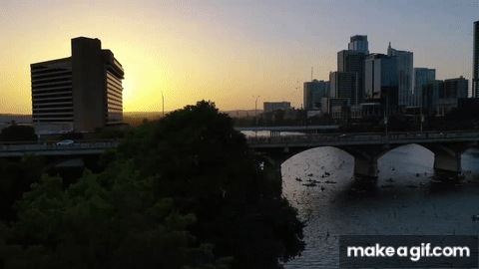

Slide 3
What questions come to your mind?

Slide 4
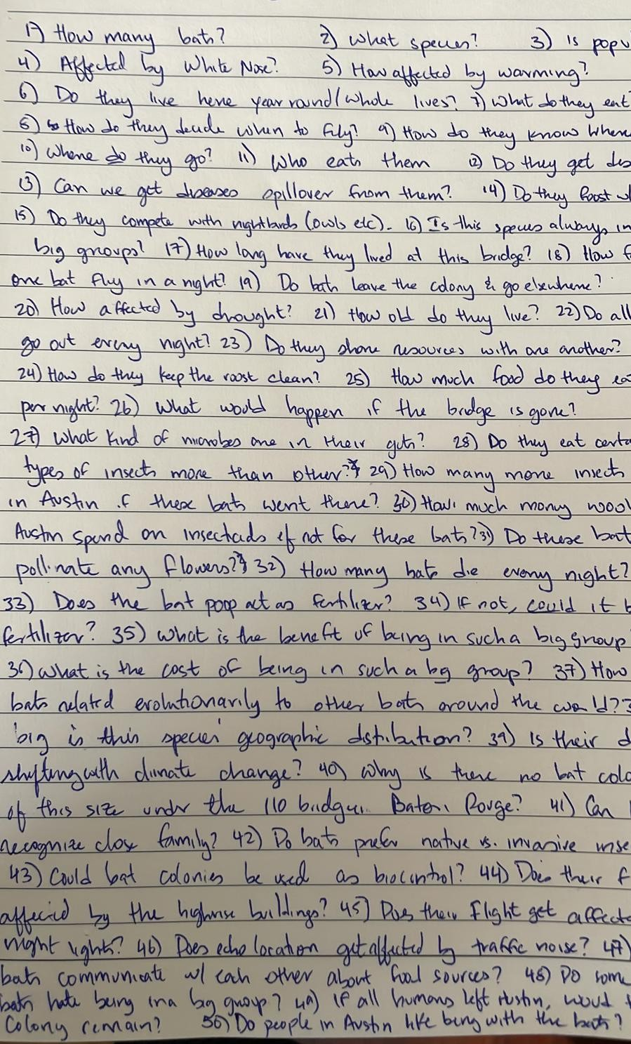

Slide 5
Course Introduction

Slide 6
About me
Quantitative plant ecologist and educator
Research focus: How are the above-ground dynamics of plant communities affected by below-ground microorganisms?
How to call me: Dr. Kandlikar (like “candy car”, but “candly-car”), or Dr. G, or Dr. K, or Gaurav
For more information, go to my lab website: https://gklab.org

Slide 7
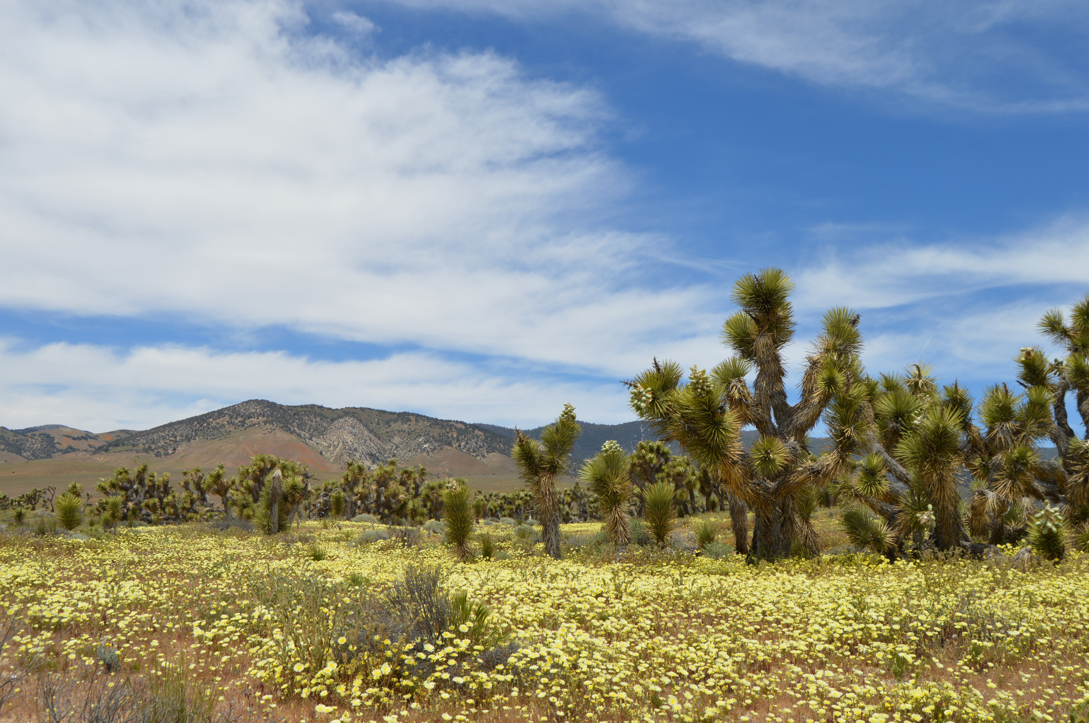
Places I’ve worked

Slide 8
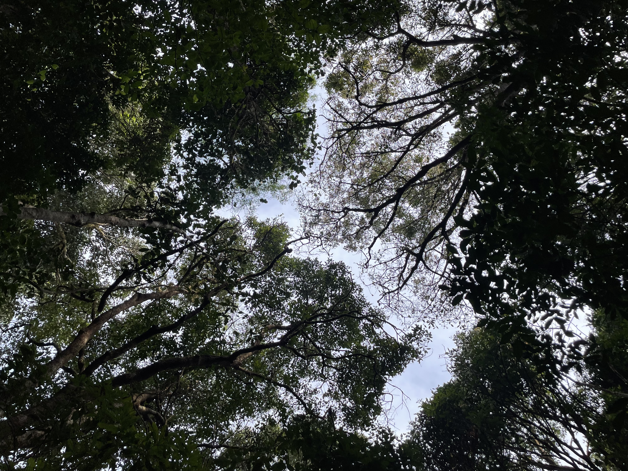

Slide 9
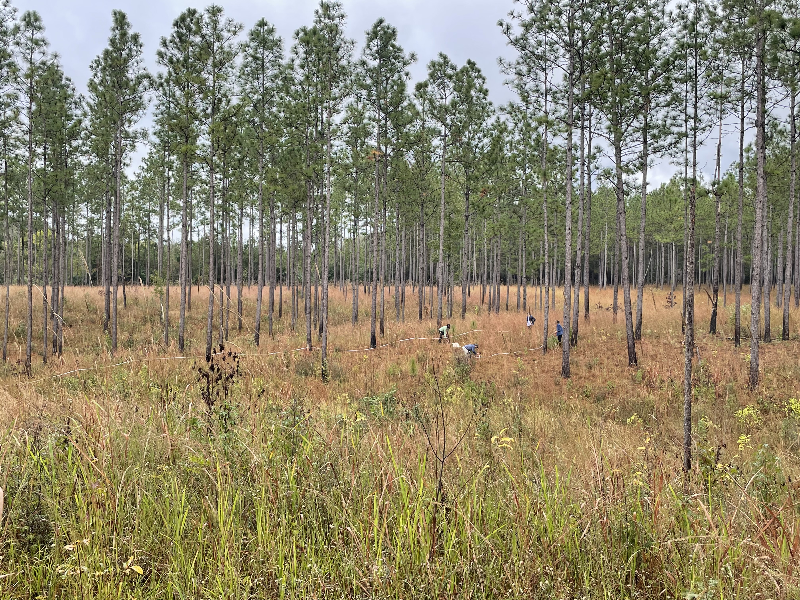

Slide 10
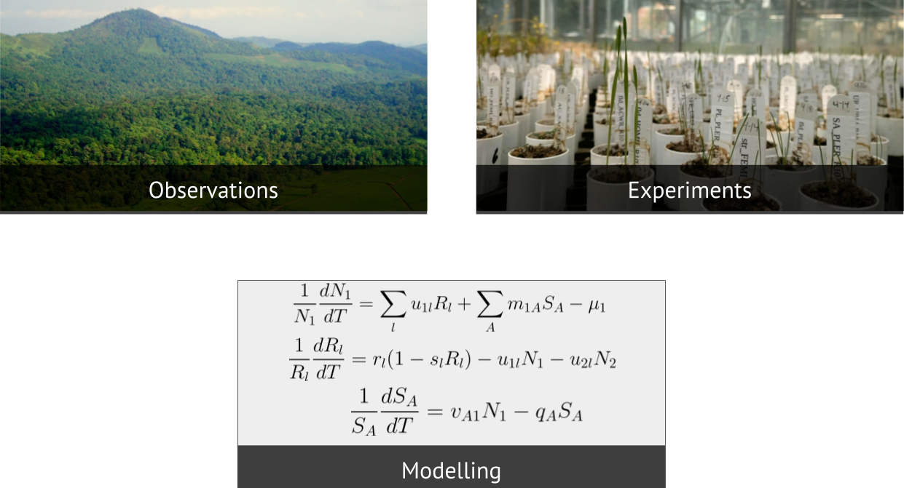
Approaches to ecology

Slide 11
I want to get to know you!
Please fill out the “Who’s in class” survey on Moodle!
What does “Ecology” mean to you?

Slide 12
What is Ecology?
Ecology as a discipline is motivated by human efforts to describe, understand, predict, and modify nature.
Contemporary ecology research aims to understand (i) the factors that shape where organisms live, (ii) how their abundances change over time, (iii) how interactions shape communities and ecosystems, and (iv) how these are affected by global environmental change.
This course will introduce you to the questions that motivate the field of ecology, the approaches that ecologists take, and the implications of ecological research for societal challenges.

Slide 13
Let’s return to the bats
A simple question: How many bats live in this group?
Use your intuition: what do you think?
Why is this simple question not very simple to answer?
Some complicating factors:
  Our brains are bad at processing big (or small) numbers
  Population size changes over time – so, when do we want to know?
  The bats don’t exist in a vacuum – how do interactions (with other organisms, with human decisions, etc.) shape this population?

Slide 14
These challenges highlight some common themes in ecology:
Ecological systems are dynamic, meaning that their properties can change over time.
Ecological systems are structured by feedacks, meaning that the dynamics of one component often affects others.
Understanding ecological systems requires us to confront uncertainty, which can arise for various reasons.
The dynamics and wellbeing of ecological systems are tightly intertwined with the wellbeing of human societies.

Slide 15
This semester, you will develop skills to:
Describe how the field of ecology tackles complexity
Explain how mathematical thinking helps generate ecological insights
Interpret figures and results from published ecological literature
Discuss the role of ecology in addressing major societal challenges.

Slide 16
Case study: Explain how mathematical thinking helps generate ecological insights
How many bats live in this group?
Mark-Recapture as a method to estimate of population size:
Capture and mark (tag) some number of individuals
Release tagged individuals and allow the population to re-equilibrate
Once population is settled (e.g. in the case of bats - on a different night), capture some number of individuals
The proportion of individuals that are marked in your second sample can give you a good estimate of the total population size

Slide 17
Mark-Recapture as a method to estimate of population size:
$N_{Marked}$: number of individuals marked in first sample
$N_{Captured}$: number of individuals captured in second sample
$N_{Captured, Marked}$: number of individuals in the second sample that are marked
$N_{Total, Estimated}$: estimate of total population size
$$N_{Total, Estimated}=\frac{N_{Marked}*N_{Captured}}{N_{Captured, Marked}}$$

Slide 18
Worked example
On your first sampling day, you mark 200 bats with a metallic tag ($N_{Marked}=200$)
You return to the bridge next week, and capture 1500 bats ($N_{Captured}=1500$)
Of the 1500, only 17 bear the metallic tag mark ($N_{Captured, Marked}=17$)
Intuition: Since you marked 200 bats initially and only recaptured 17 in a large sample of 1500, you were only able to mark a small fraction of the bats!
$$N_{Total, Estimated}=\frac{N_{Marked}*N_{Captured}}{N_{Captured, Marked}}=\frac{200*1500}{17}≈17647 bats$$

Slide 19
Course logistics

Slide 20
Course rhythm
In-class sessions will be a mix of lecture, hands-on activities, and discussions.
You are responsible for engaging with the Readings and other Resources made available to you on Moodle before coming to class.
Most submissions will be due on Sunday nights at 11.59pm via Moodle; in some weeks, you will be asked to bring in copies of your submission to class (hard copy or digital copy on laptop/tablet is fine)

Slide 21
Evaluation and grading
Grading philosophy
As an instructor, my goal for this class is for each of you to achieve the core learning objectives for our course.
A huge body of research by colleagues in education shows that grades are a poor motivator for learning, and a poor predictor of future success.
This shapes how the course is structured:
  No high-stakes, “one size fits all” exams
  Low-stakes assignments throughout the semester
  Considerable opportunity for each student to earn the grade they aspire to

Slide 22
Evaluation and grading
Your grade in this class will reflect your performance in three areas:
Self reflections (biweekly)
Biweekly activities (mostly completed in-class)
Semester project (more on this next week)

Slide 23
Self reflections
The goal is to help you take a step back and reflect more generally on your growth as a scientist over the semester
I encourage you to think about how the material we are learning in-class relates (or doesn’t relate) to your life more generally
I will include a list of potential reflection topics, but I encourage you to think broadly about what matters to you.
First self reflection due next Sunday night (Sept 7), and then every other Sunday night.

Slide 24
Why self reflections?
Learning happens not only through doing, but by reflecting on what we are doing (metacognition) – see the scholarship of Dr. Saundra McGurie, emeritus director of LSU Center for Academic Success.
Make space for deliberately thinking about how lessons from basic ecology apply to our increasingly complex and “weird” environment
Reflect on what topics you find especially engaging and/or especially challenging

Slide 25
Self reflections
Themes for first self reflection:
Reflections on ecology
What does the word “ecology” mean to you? How do you think it is relevant to your life?
What is your relationship with “nature”? In your mind, how can humans have a healthy relationship with nature?
Is there a particular place that comes to your mind when you think of “being out in nature”? What kinds of characteristics define that space for you?
Reflections on the semester
What are some things you are excited about for this semester? What are some things you are nervous about?
Looking at your semester schedule, are there going to be particular weeks that are looking busier (multiple exams/assignments due, etc.)? If so, how are you planning to prepare for these weeks?
Two weeks into the semester, how do you see this course relating to the other courses you are taking, or to other activities in your life outside of this class?

Slide 26
Evaluation of self reflections
Over the semester, you will have the opportunity to submit seven self reflections, each worth 10 points
Only six of these will be counted towards the final grade, meaning that you have one “free pass”.
Each self reflection comes with a 24-hour grace period for submission.
I will read self-reflections to get a sense of how the class is going.
You will grade your own self reflections at the end of the semester, for a score out of 60 points. A rubric is available here.

Slide 27
In-class activities
Approximately every other week starting in Week 3, you will be asked to complete an activity related to the material covered in the past two weeks
The exact format will vary across the semester (e.g. reading primary ecological literature in some weeks; completing quantitative worksheet in another, etc.)
These will be completed in-class, usually on Wednesdays or Fridays.

Slide 28
Evaluation of in-class activities
Graded by Dr. Kandlikar, following an exemplar that will be made available on Moodle.
There will be 7 biweekly activities assigned through the semester, each worth 10 points
Only six of these will be counted towards the final grade, meaning that you have one “free pass”.

Slide 29
Weekly readings and other resources
Each week, I will post resources on the course website and moodle, which I expect you to complete before coming to class
These will include a range of formats, including video lectures by me or other ecologists, textbook chapters, primary ecological literature, podcast episodes, and material from the news.

Slide 30
Co-Working sessions
Each week, I will be available for two co-working sessions: 3-4 on Tuesdays, or 3.30-4.30 on Wednesdays.
Available for discussions regarding course content, professional development, etc.
If you need to meet separately, reach out to schedule a meeting.

Slide 31
Course structure: How is the material organized?

Slide 32
Levels of ecological organization
Organism
Population
Community
Landscape
Ecosystem
We will focus mostly on populations, communities, landscapes, and ecosystems; less at the organismal level.

Slide 33
Population ecology:
How do individuals of a given species (“conspecific individuals”) interact with one another?
Does the nature of interactions vary across environments?
How do these interactions affect population dynamics?
Under what conditions do populations grow, shrink, or stabilize?

Slide 34
Community ecology:
How do individuals of different species (“heterospecific individuals”) interact with one another?
Does the nature of interactions vary across environments?
Why are some species able to coexist with one another over long timescales, while other sets of species cannot persist with one another?
What regulates the dynamics of species interactions across trophic levels (e.g. predator–prey interactions)?

Slide 35
Landscape ecology:
What are the patterns of diversity across ecological gradients?
What processes give rise to variation in biodiversity across space and time?
How does human land use change restructure ecological communities?

Slide 36
Ecosystems ecology:
How do energy and nutrients flow across ecosystems, for example at the scale of entire continents?
What are the consequences of disruptions to ecosystems cycles?
How do feedback loops shape the dynamics of ecosystems?

Slide 37
Common themes at all scales
Ecological systems are dynamic, meaning that their properties can change over time.
Ecological systems are structured by feedacks, meaning that the dynamics of one component often affects others.
Understanding ecological systems requires us to confront uncertainty, which can arise for various reasons.
The dynamics and wellbeing of ecological systems are tightly intertwined with the wellbeing of human societies.

