Slide 1
Limits to population growth

Slide 2
Exponential and stage-structured population growth

Slide 3
Exponential growth
$$\frac{dN}{dt}=rN$$
Stage-structured growth
N_{t+1} = [transition matrix] * [population vector]

Slide 4
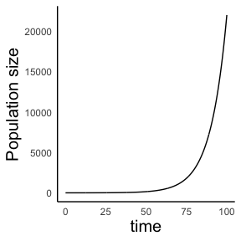
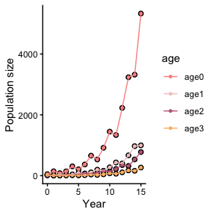
Exponential growth
$$\frac{dN}{dt}=rN$$
Stage-structured growth
N_{t+1} = [transition matrix] * [population vector]

Slide 5
When is population at equilibrium?
(But first, what is “Equilibrium” in ecology?)
In ecological systems, “equilibrium” means no change in population size (or other relevant aspect of a system) over time
Under exponential population is at equilibrium only when $N=0$
Populations with $r=0$ or $λ=1$ are also at equilibrium (no net births or deaths)

Slide 6
Model assumptions
No immigration or emigration (Closed population)
Constant birth and death rate ($b$ and $d$ don’t vary with $N$)
No variation within population (all individuals have similar $b$ and $d$) (This implies that $b$ and $d$ don’t vary with age or stage)
Continuous population growth without time lags (e.g. no seasonality)

Slide 7
Model assumptions
No immigration or emigration (Closed population)
Constant birth and death rate ($b$ and $d$ don’t vary with $N$)
No variation within population (all individuals have similar $b$ and $d$) (This implies that $b$ and $d$ don’t vary with age or stage) We relaxed this for stage-structured growth
Continuous population growth without time lags (e.g. no seasonality)

Slide 8
Model assumptions
No immigration or emigration (Closed population)
Constant birth and death rate ($b$ and $d$ don’t vary with $N$) Today, we will relax this assumption? –> Density-dependent growth
No variation within population (all individuals have similar $b$ and $d$) (This implies that $b$ and $d$ don’t vary with age or stage)
Continuous population growth without time lags (e.g. no seasonality)

Slide 9
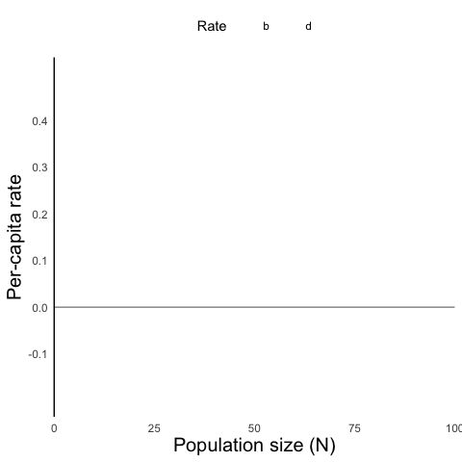
So far, we assumed constant birth and death rate ($b$ and $d$ don’t vary with $N$)

Slide 10
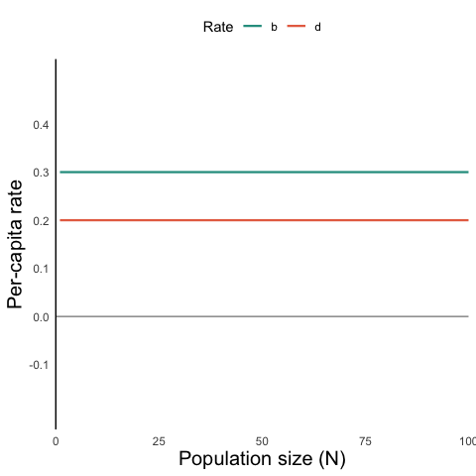
So far, we assumed constant birth and death rate ($b$ and $d$ don’t vary with $N$)

Slide 11
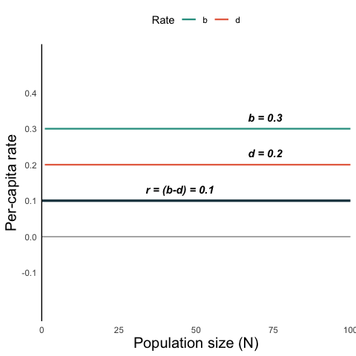
So far, we assumed constant birth and death rate ($b$ and $d$ don’t vary with $N$)

Slide 12
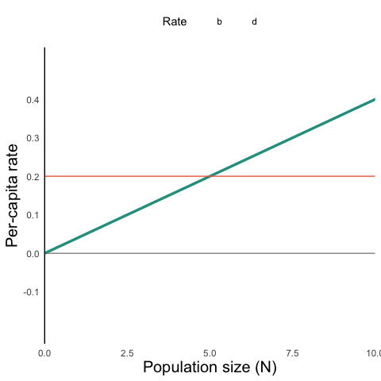
What if $b$ and $d$ are not constant?
We can easily imagine scenarios in which birth and death rates vary with population size.
In social species (bees, ants, wolves, some woodpeckers, etc.), birth rates ($b$) might increase with population size

Slide 13
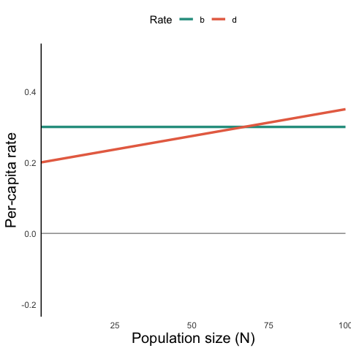
What if $b$ and $d$ are not constant?
We can easily imagine scenarios in which birth and death rates vary with population size.
Under strict resource limitation, mortality rate might increase with population size
  Could also happen without resource limitation, e.g. higher rates of disease spread

Slide 14
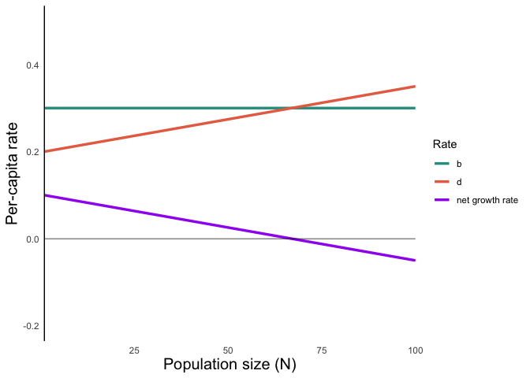
Under this assumption ($d$ increases with $N$), we see that there is a point at which $\text{growth rate}=0$.

Slide 15
$r$ is the growth rate when $N=0$

Slide 16
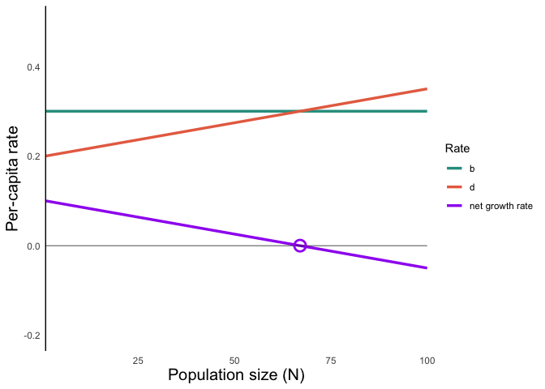
What happens when $b−d=0$?
Birth rate equals death rate
No change in population size

Slide 17
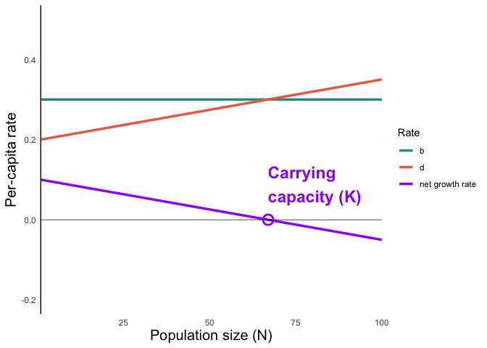
The population size ($N$) at which growth rate equals zero is called the carrying capacity ($K$)

Slide 18
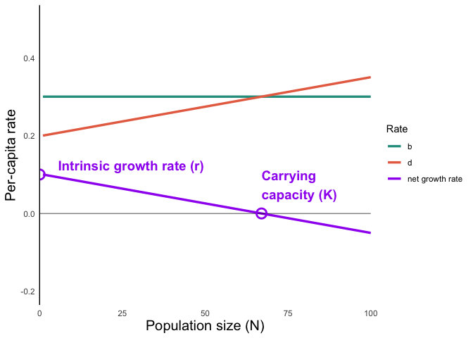
The population size ($N$) at which growth rate equals zero is called the carrying capacity ($K$)
The population’s growth rate at $N=0$ is $r$

Slide 20
The per-capita population growth rate ($\frac{1}{N}\frac{dN}{dt}$) for a population of a given size is the Y-axis value.
  The closer a population is to $N=0$, the closer its actual growth rate is to $r$
  The closer a population is to $N=K$, the closer its actual growth rate is to $0$
  Populations that are bigger than K have negative population growth (until they fall back to carrying capacity)

Slide 21
Mathematical expression
What is the equation of the purple line?

Slide 22
Recall from algebra that we can use the “point-slope” approach for the slope of a line ($y−y_{1}=m(x−x_{1})$)
We know two points: $(0,r)$ and $(K,0)$
The slope of the line turns out to be $−\frac{r}{K}$, which we write as $α$
And $y$ gives the per-capita population growth rate $\frac{1}{N}\frac{dN}{dt}$

Slide 23
Mathematical expression
What is the equation of the purple line?
So, we can express the line as
$$\frac{1}{N}\frac{dN}{dt}=r−αN$$
Through rearranging, we get back to the equation for “realized” population growth rate (not per-capita):
$$\frac{dN}{dT}=(r−αN)N$$
This is equivalent to
$$\frac{dN}{dT}=rN(1−αN)$$
On your own: Convince yourself through algebra that this is equal to the canonical form of the equation:
$$\frac{dN}{dt}=rN\left(1−\frac{N}{K}\right)$$

Slide 24
$$\frac{dN}{dt}=rN\left(1−\frac{N}{K}\right)$$
When population size is very small ($N→0$), $\frac{N}{K}→0$, and the population grows ‘exponentially’
When population size is close to carrying capacity ($N→K$), $\frac{N}{K}→1$, and the population remains constant
When population size exceeds carrying capacity ($N>K$), $\frac{N}{K}>1$, and the population growth rate is negative (shrinks)
“Logistic growth” model

Slide 25
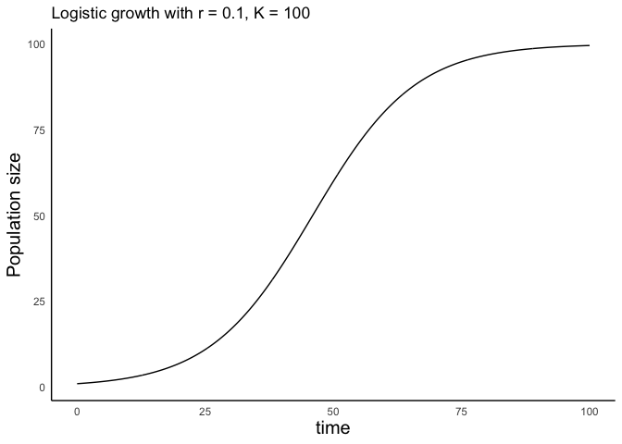
Population growth over time

Slide 26
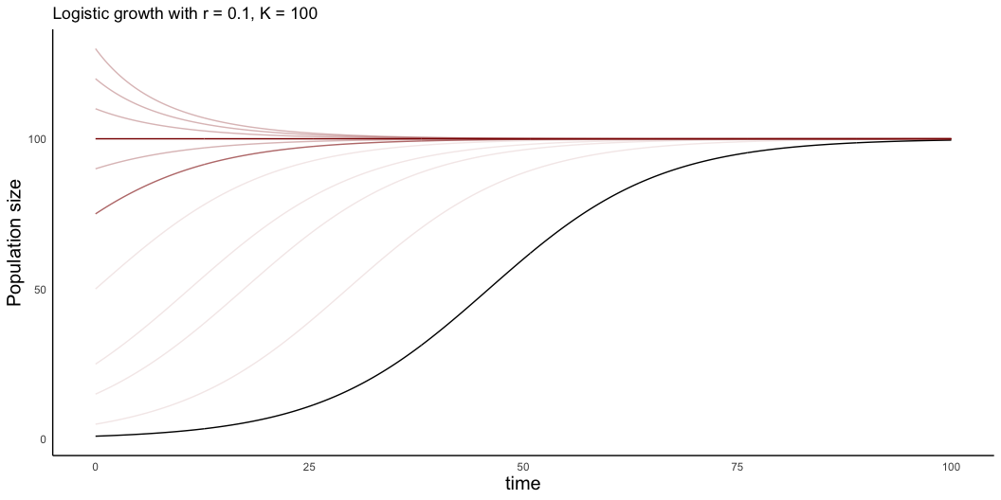
Population growth over time
The population will converge to the carrying capacity no matter the initial size

